Slide 1
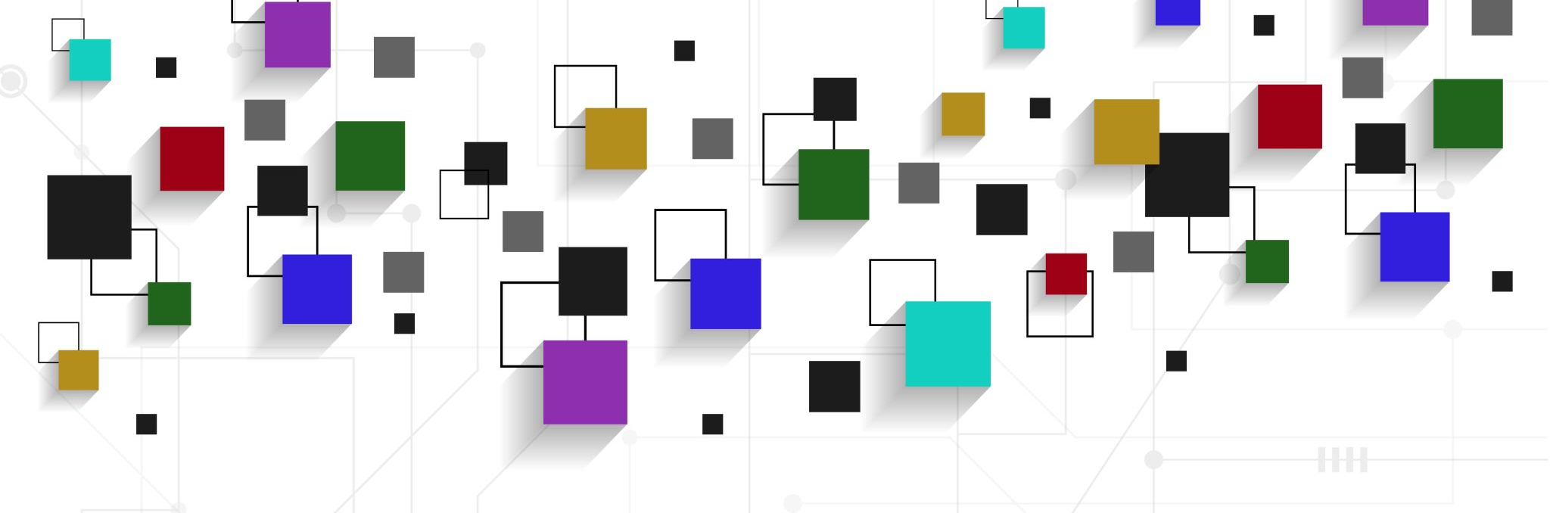
IT356 Final Project
Shane Stevens

Slide 2
Program 1
Model loaded using assimp
Explosion created using geometry shader
Skybox uses cubemapping
Movement uses rotation, translation, and scaling

Slide 3
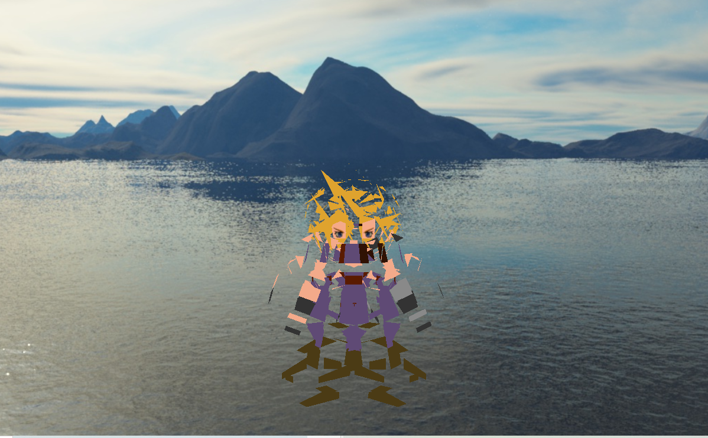
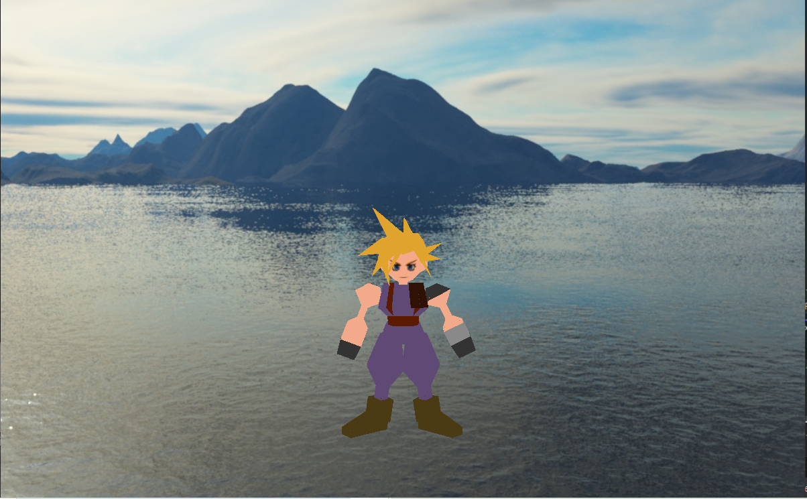
Explosion
Causes the tris that make up the model to move in and out

Slide 4
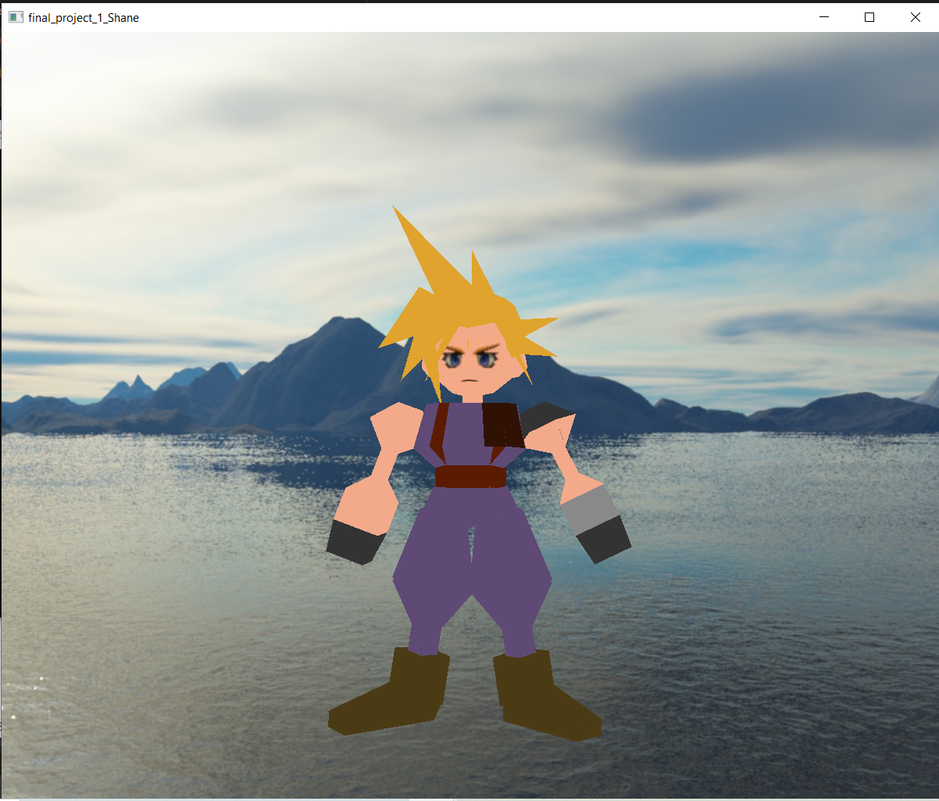
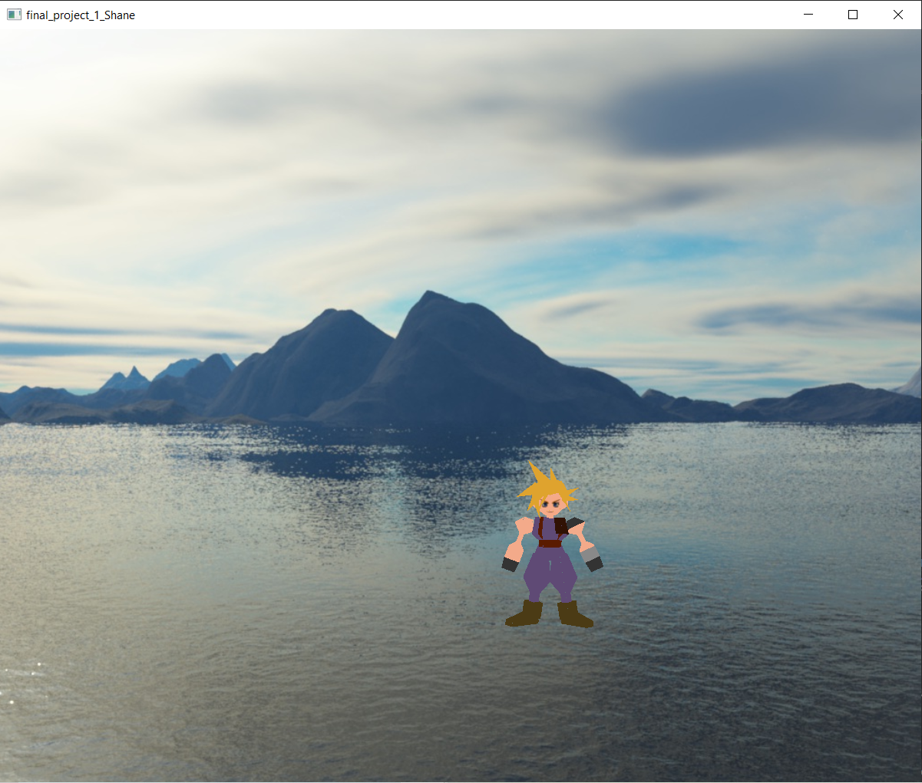
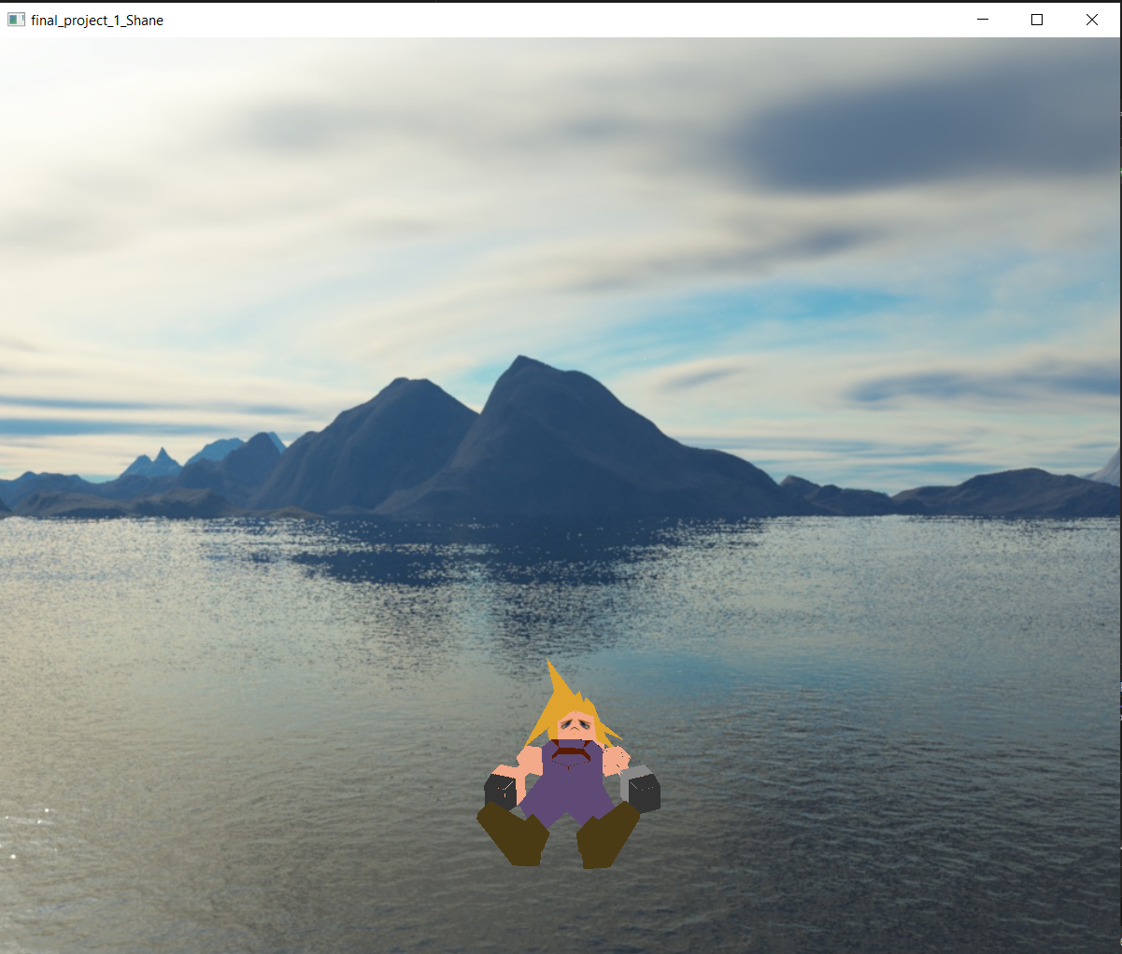
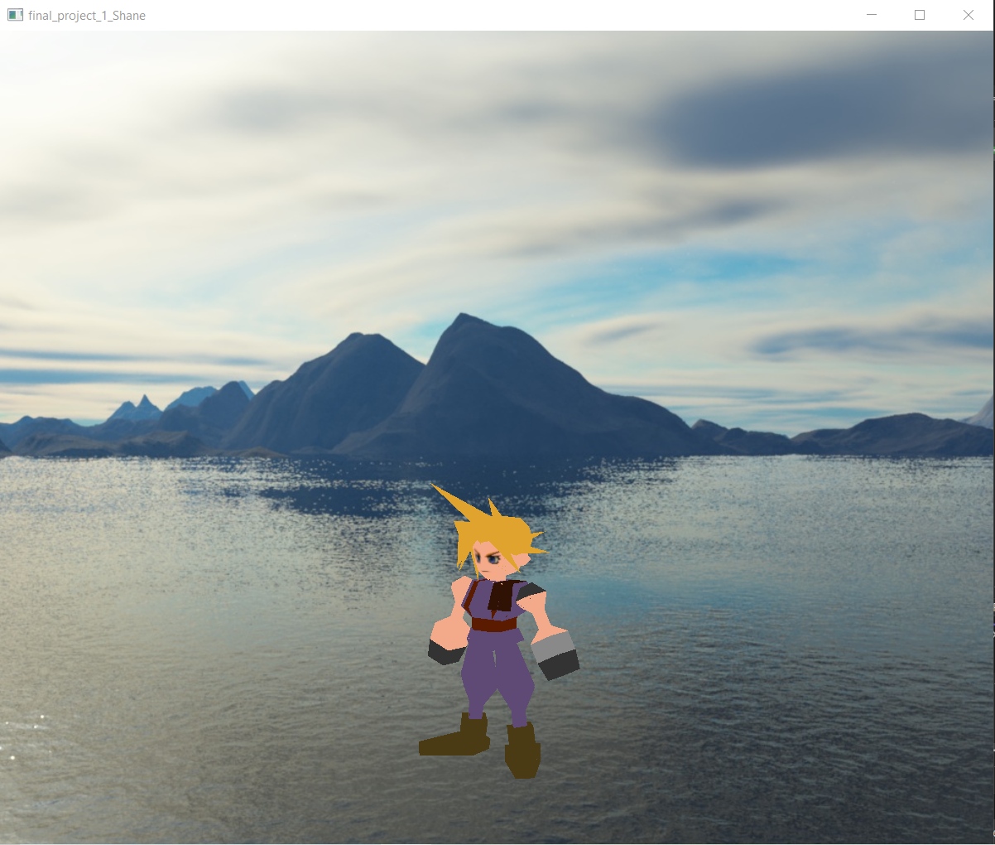
Movement/scaling/rotating
Can rotate around the X and the Y axis
Movement uses sin, cos, and tangent in a translation to make the model move in a cool way

Slide 5
Program 2
Lighting uses the Phong optical model with a spotlight
Cubes use texture mapping
Movement uses translation and rotation
Background color changing uses the clear color
The two different textures on the cube used gl_FrontFacing

Slide 6
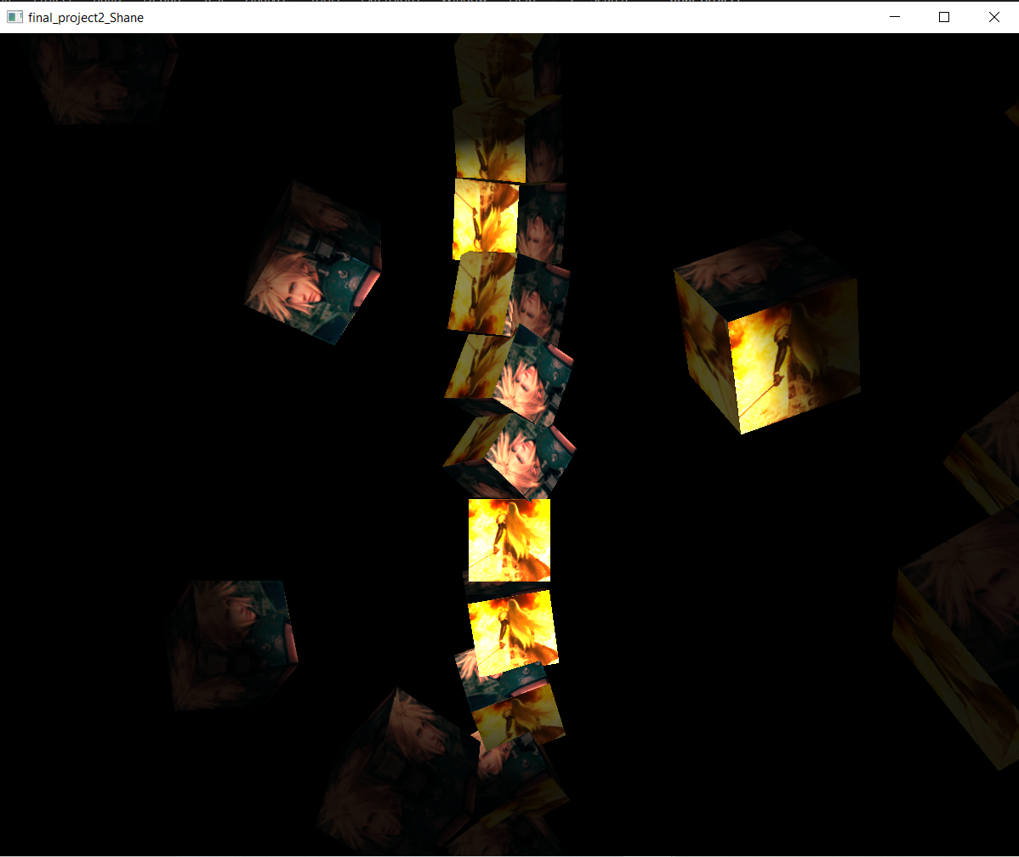
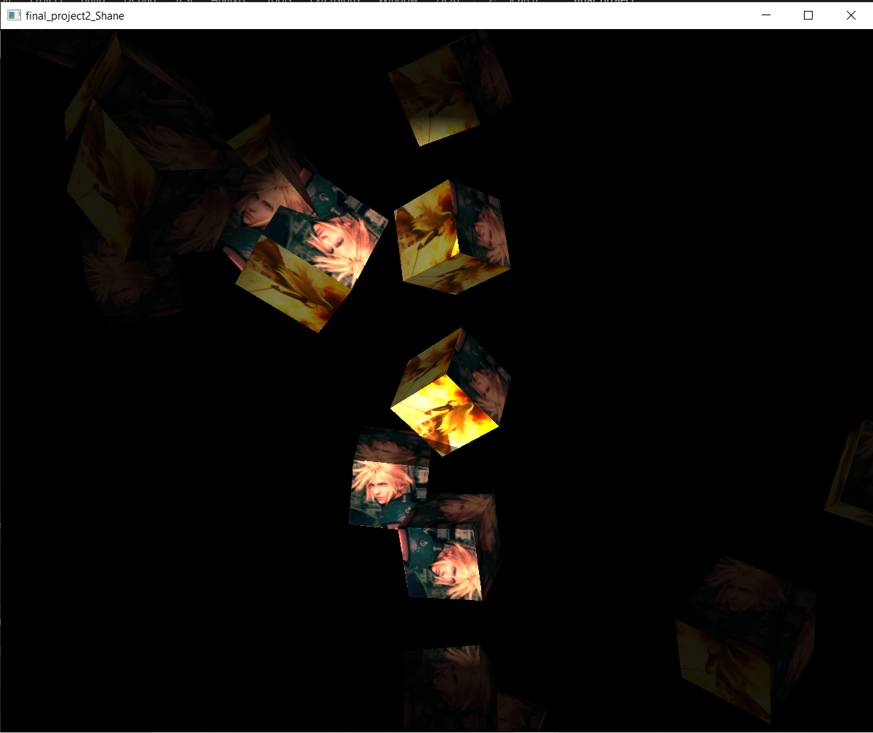
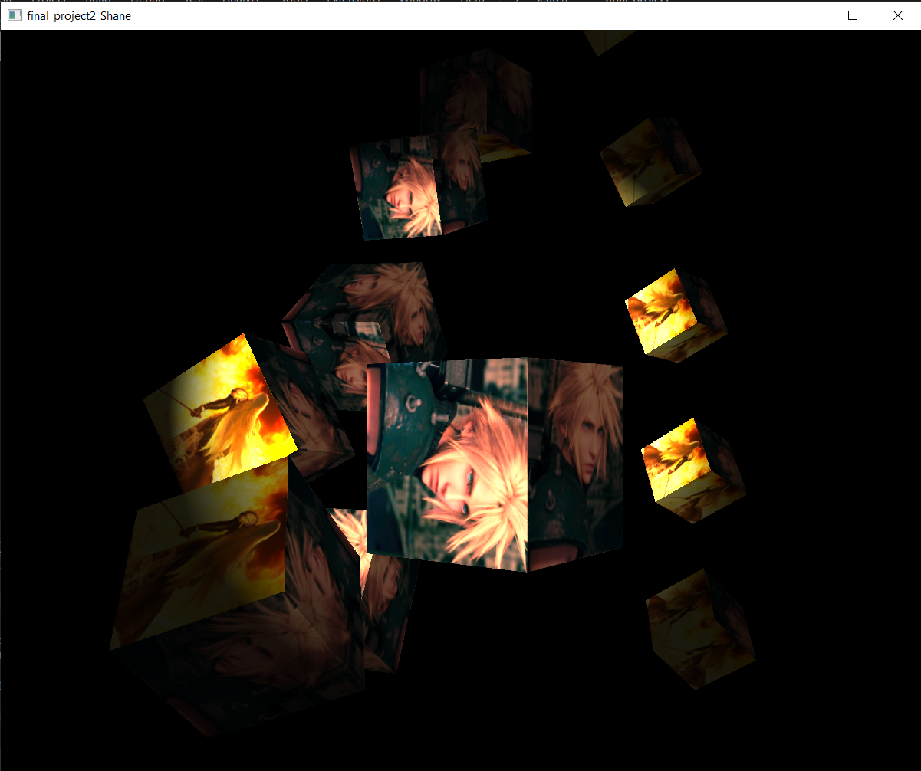
Movement
Movement used translation and rotation along with the for loop that draws the squares to cause the squares to move in different ways

Slide 7
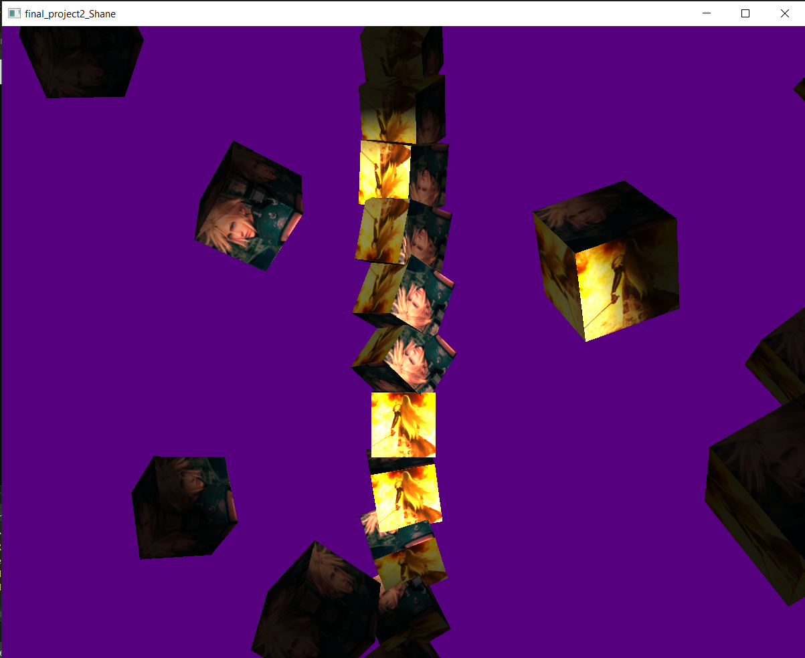
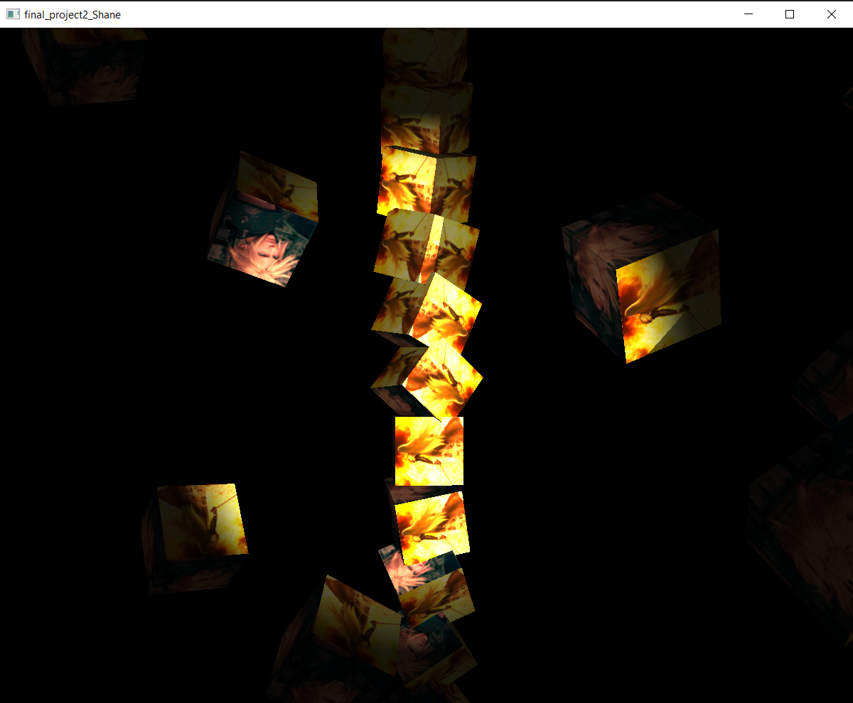
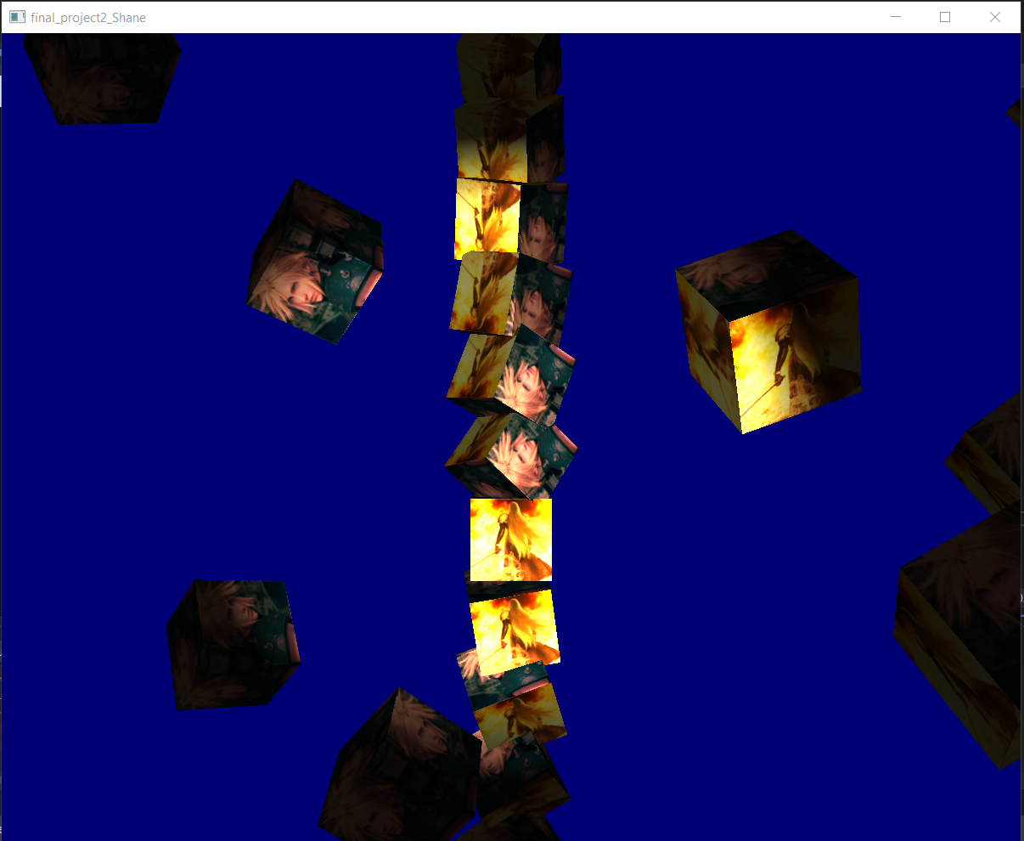
Changing background color
This was handled by having the clear color use sin(glfwGetTime()) to change the background color

